Slide 1
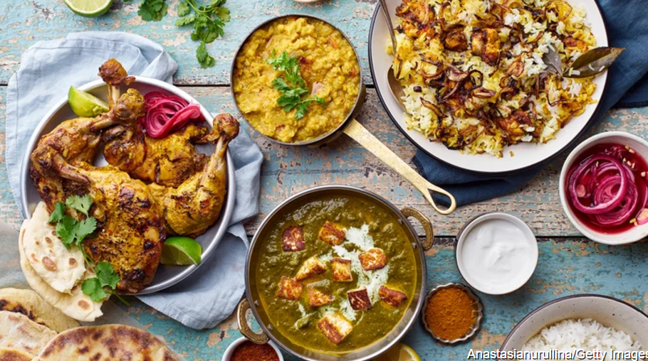
ASIAN (PAKISTANI) FOODS
BY ASIMA BIBI

Slide 2
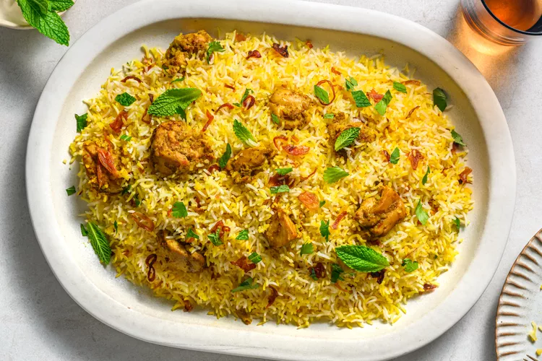
Biryani
Biryani is a mixed rice dish, mainly popular in South Asia. It is mainly meat and lots of seasonings and spices. To cater to vegetarians in some cases, it is prepared by substituting vegetables or paneer for the meat. Sometimes eggs or potatoes are also added.

Slide 3
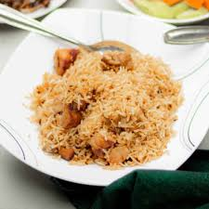
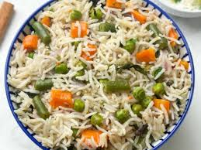
Pulao
Pulao is a spiced rice dish that is often served on festive occasions. It is made with rice, vegetables, and animal protein and is served with a side of. Pulao can be made with any size grain of rice, which the chef always fries in oil while stirring in large amounts of dry spices. Usually, there will be a chunk.

Slide 4
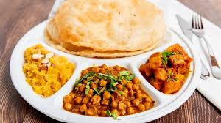
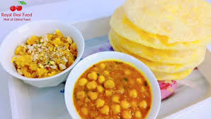
Halwa Puri
Halwa Puri is one of the most popular comfort foods in Pakistan. It's made with a sweet semolina pudding called Halwa and a fried dough called Puri and is a combination of Chana Curry masala and a deep-fried bread made from maida. Usually used in Breakfast.

Slide 5
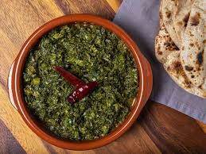
Saag
Saag also spelled sag or saga, is an Punjabi leafy vegetable dish eaten with bread, such as roti or naan, or in some regions with rice. Saag can be made from mustard greens, collard greens, basella or finely chopped broccoli along with added spices and sometimes other ingredients, such as chhena. Saag. When it comes to vegetable dishes in Pakistan, 'Saag' is much cherished. Made from mustard leaves, methi, and spinach.

Slide 6
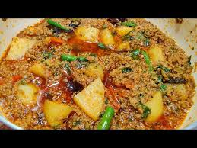
Aloo Keema
Aloo Keema (Ground Beef and Potato Curry) Here's a dish for an authentic, home-style, Pakistani & North Indian style Aloo Keema (Keema Curry with potatoes). It consists curried, minced or ground meat (keema) and potatoes (aloo).

Slide 7

THANKS FOR WATCHING!

